Slide 1
Intellectual Property
Navaneeth Balaji | z5135610
Zachary Gilmour | z5162828
Cary Guan | z5160345
Carlin Williamson | z5122521
Andrew Wong | z5206677

Slide 2
Introduction
trademarks
patents
trade secrets
re
copyright
piracy
"Intellectual property (IP) refers to creations of the mind, such as inventions; literary and artistic works; designs; and symbols, names and images used in commerce"
Source: WIPO (World Intellectual Property Organization)

Slide 3
Trademarks™️
trademarks
patents
trade secrets
re
copyright
piracy
Protection of slogans, logos, catch phrases, company names, characters
"Good Faith" usage of others' trademarks
Descriptive Use
Intended Purpose
Section 120-124 of the Trade Marks Act 1995

Slide 4
📝 Patents
trademarks
patents
trade secrets
re
copyright
piracy
Exclusive commercial rights to an invention / method in exchange for the public disclosure of its workings / process
Prevents other companies from selling your claims without permission

Slide 5
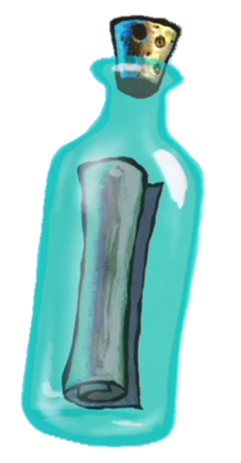
Trade Secrets 🤫
trademarks
patents
trade secrets
re
copyright
piracy
Designs, processes, methods, patterns, the Krabby Patty secret formula
that are kept confidential and private (compare this to patents).
No protection against information leaks.

Slide 6
Reverse Engineering
trademarks
patents
trade secrets
re
copyright
piracy
Is it legal?
Can a EULA forbid someone from reverse engineering?

Slide 7
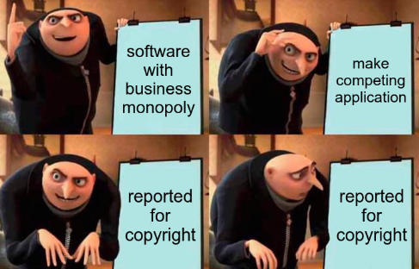
©️opyright
trademarks
patents
trade secrets
re
copyright
piracy
Grants and rights to authors of original works and creations

Slide 8
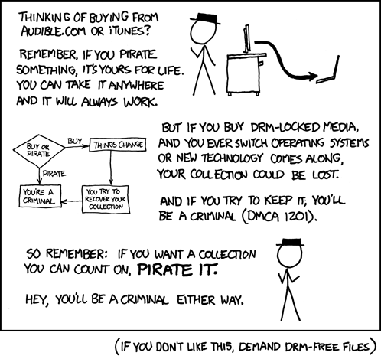
Piracy
trademarks
patents
trade secrets
re
copyright
piracy
Source: xkcd.com

Slide 9
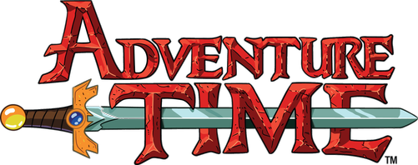
trademarks
patents
trade secrets
re
copyright
piracy
ugh, there was more?? >:(
Activity

